Slide 1
Note to teachers
Thank you for downloading this presentation from the Young People’s Trust for the Environment. You are welcome to modify it by adding your own slides or deleting ones you don’t need.
Please do not remove the photo credits from any of the photos you use and we would be very grateful if you could leave YPTE’s logo and web address on the relevant pages.
We want to encourage more and more young people to learn about taking care of our world and our website is a great starting point for this. You can find lots more supporting information by visiting the ‘Explore’ section of https://ypte.org.uk

Slide 2
HOT AREAS:
THE SAHARA DESERT
Registered charity number 1153740

Slide 3
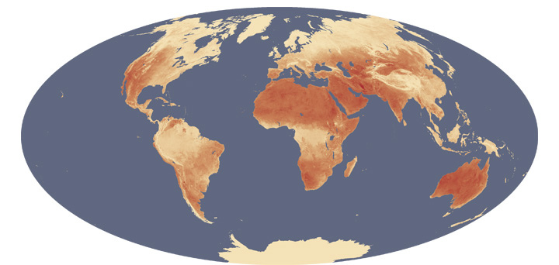
1. WHERE ARE THE HOT AND COLD AREAS?
Image: NASA’s Earth Observatory

Slide 4
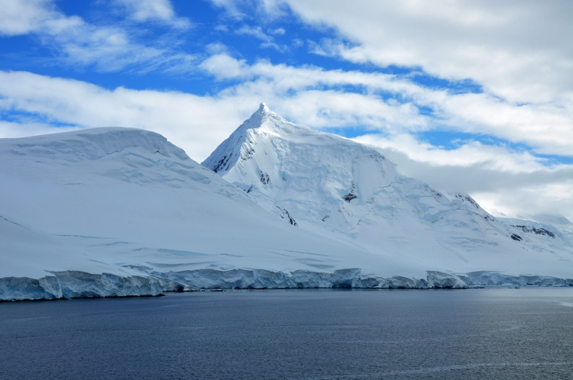
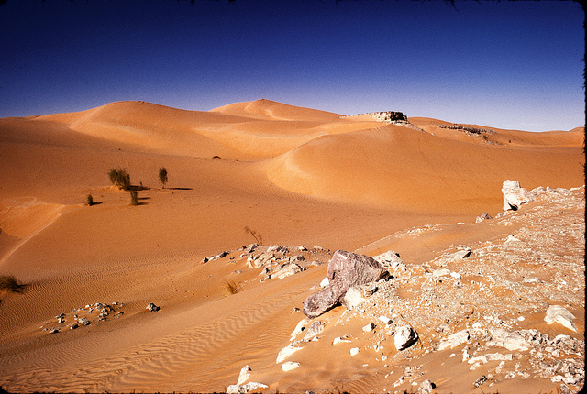
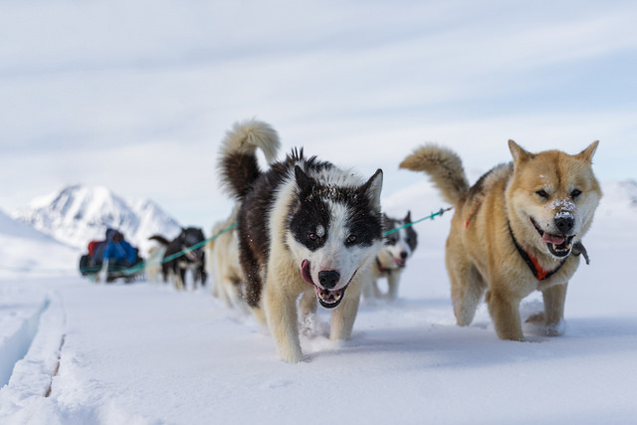
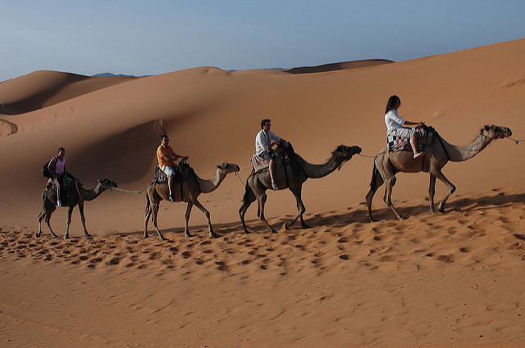
Comparing Hot and Cold Areas
Photo: Victor
Photo: Dave Price
Photo: Markus Trienke
Photo: Robbie

Slide 5
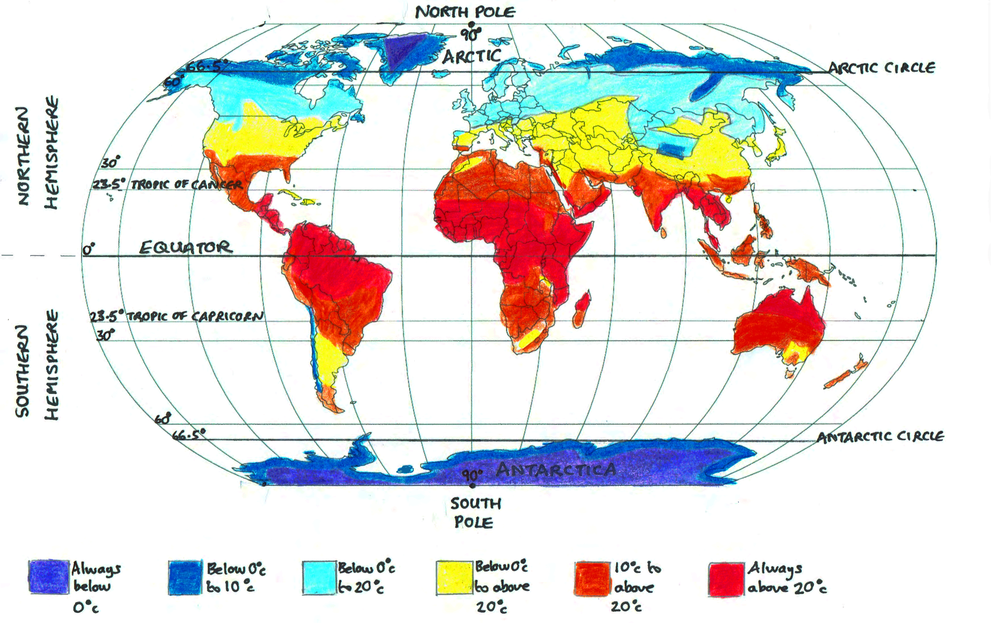
MAP SHOWING TYPICAL GLOBAL TEMPERATURES
Note: shading and lines are approximate

Slide 6
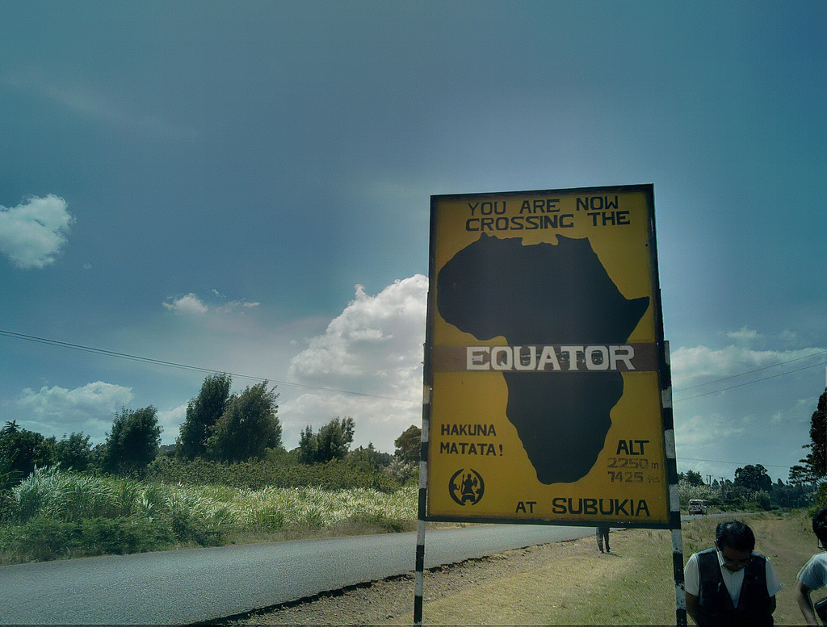
The Equator is an imaginary line around the Earth. Everywhere on the Equator is equally distant from the North Pole and the South Pole
Photo: Henri Bergius

Slide 7
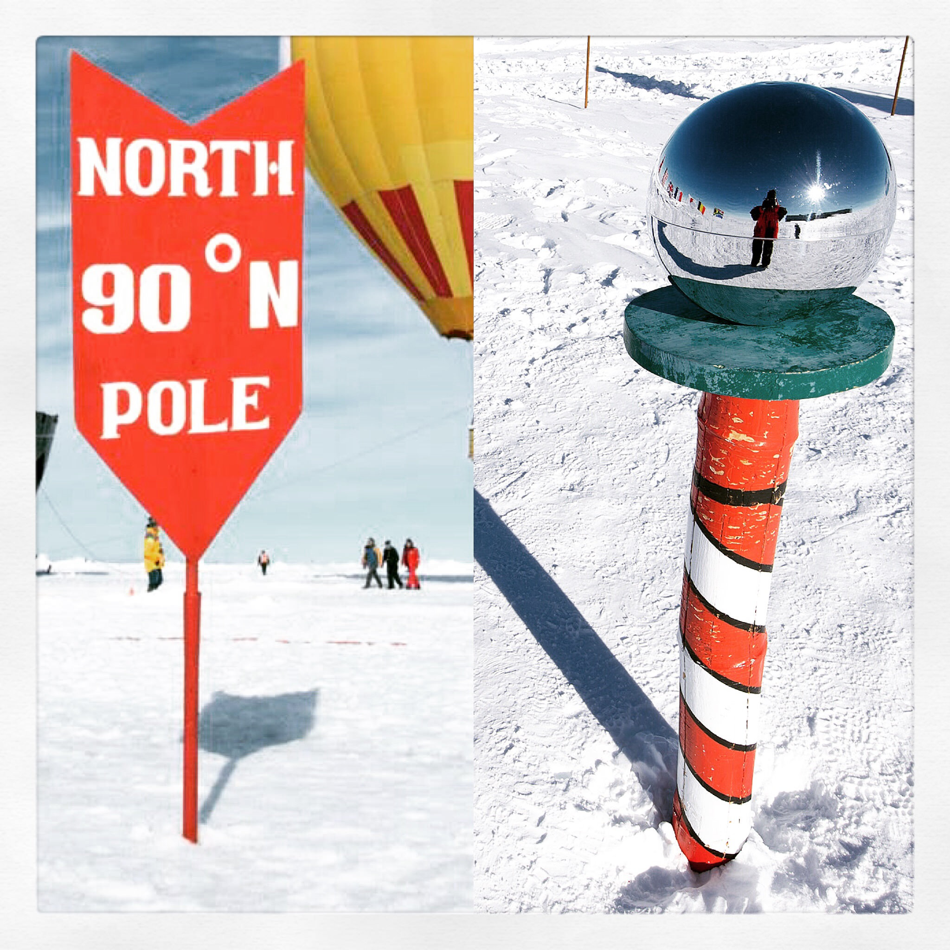
Both poles are very cold
But the South Pole is a lot colder than the North Pole
Photo: Christopher Michel

Slide 8
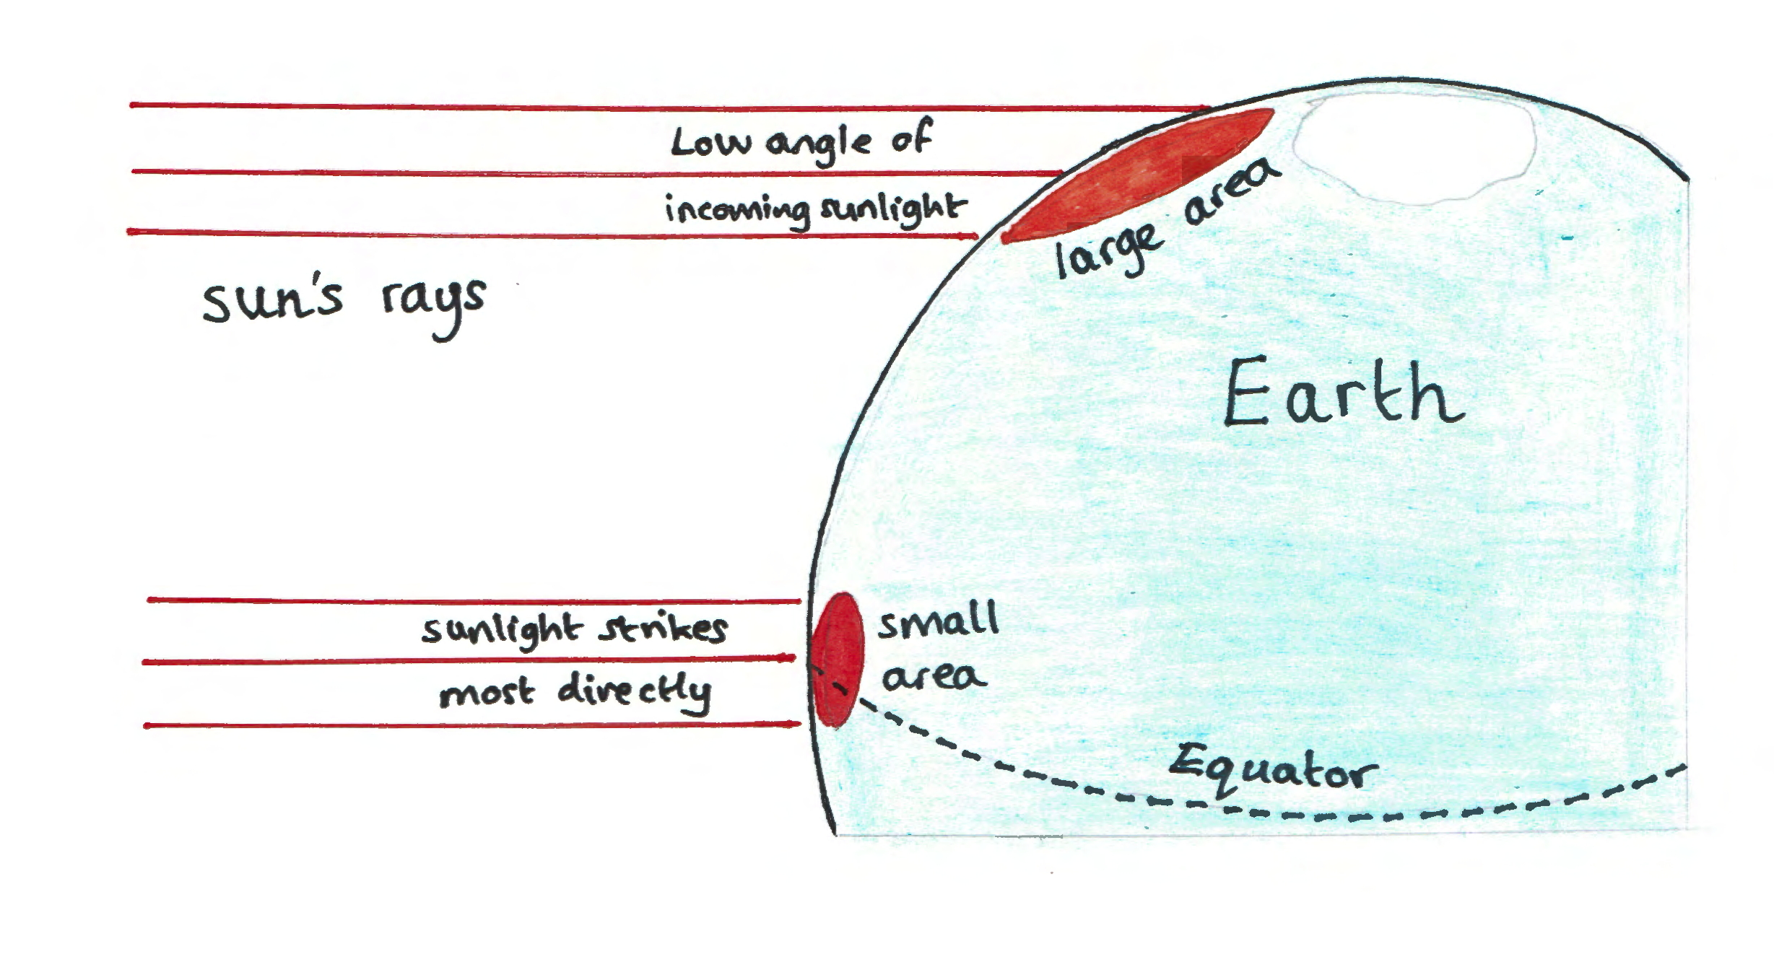
At the Poles, the sun’s rays strike the Earth at a very low angle so they are spread out over a greater area and temperatures are very low

Slide 9
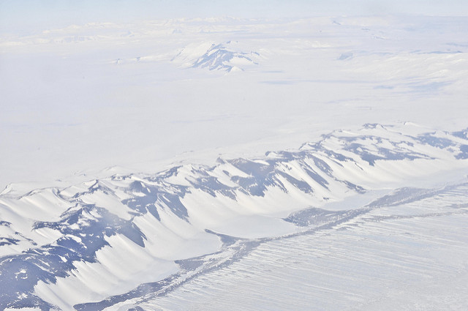
A desert is a very dry area with precipitation of less than 40cm per year. There are hot and cold deserts
Cold deserts e.g. Antarctica are cold, icy and rocky
Photo: US Embassy
Hot deserts e.g. the Sahara are hot in the day, cold at night, sandy and rocky
Photo: Dave Price

Slide 10
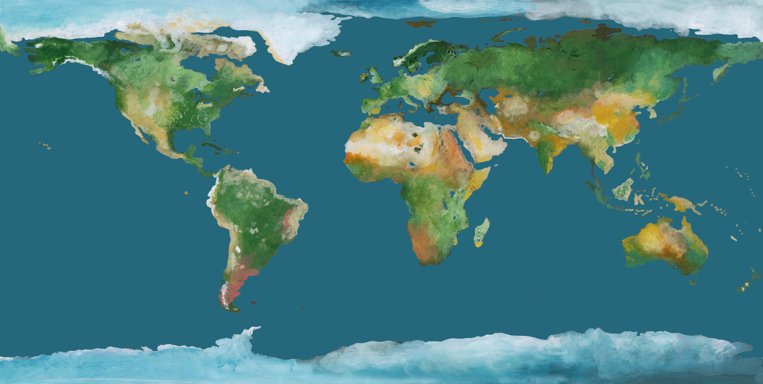
Where Are The World’s Hot Deserts?
Can you use an atlas to name the other hot deserts?
Sahara Desert
Kalahari & Namib Deserts
Arabian Desert

Slide 11
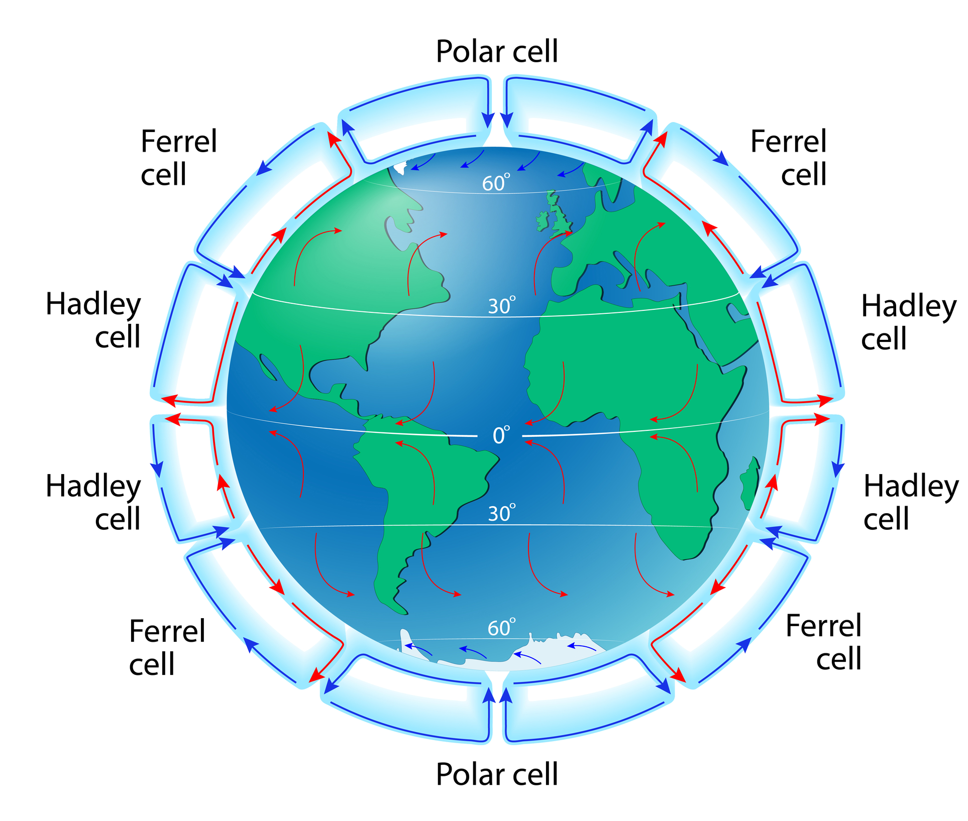
The Hadley Cell
Warm, moist air at the Equator rises and cools – condensation forms rain
The dry air travels both south and north & cools (at high altitude)
Cool dry air sinks to the surface. As the air is dry, no condensation can form so there is no rain
This is a pattern of atmospheric circulation – it explains why most hot deserts are found between 15-30º north and south of the Equator

Slide 12
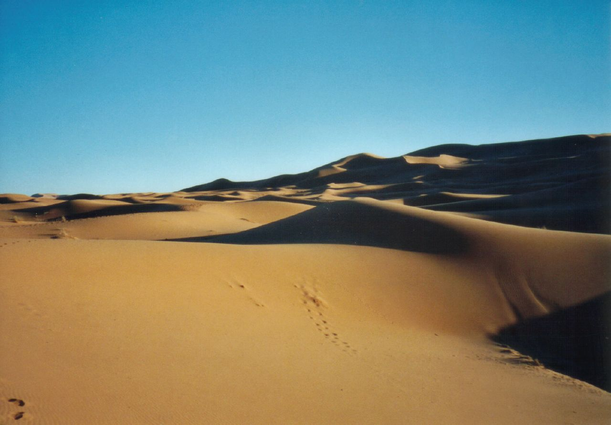
WHAT IS IT LIKE IN THE SAHARA?
Photo: mtsrs

Slide 13
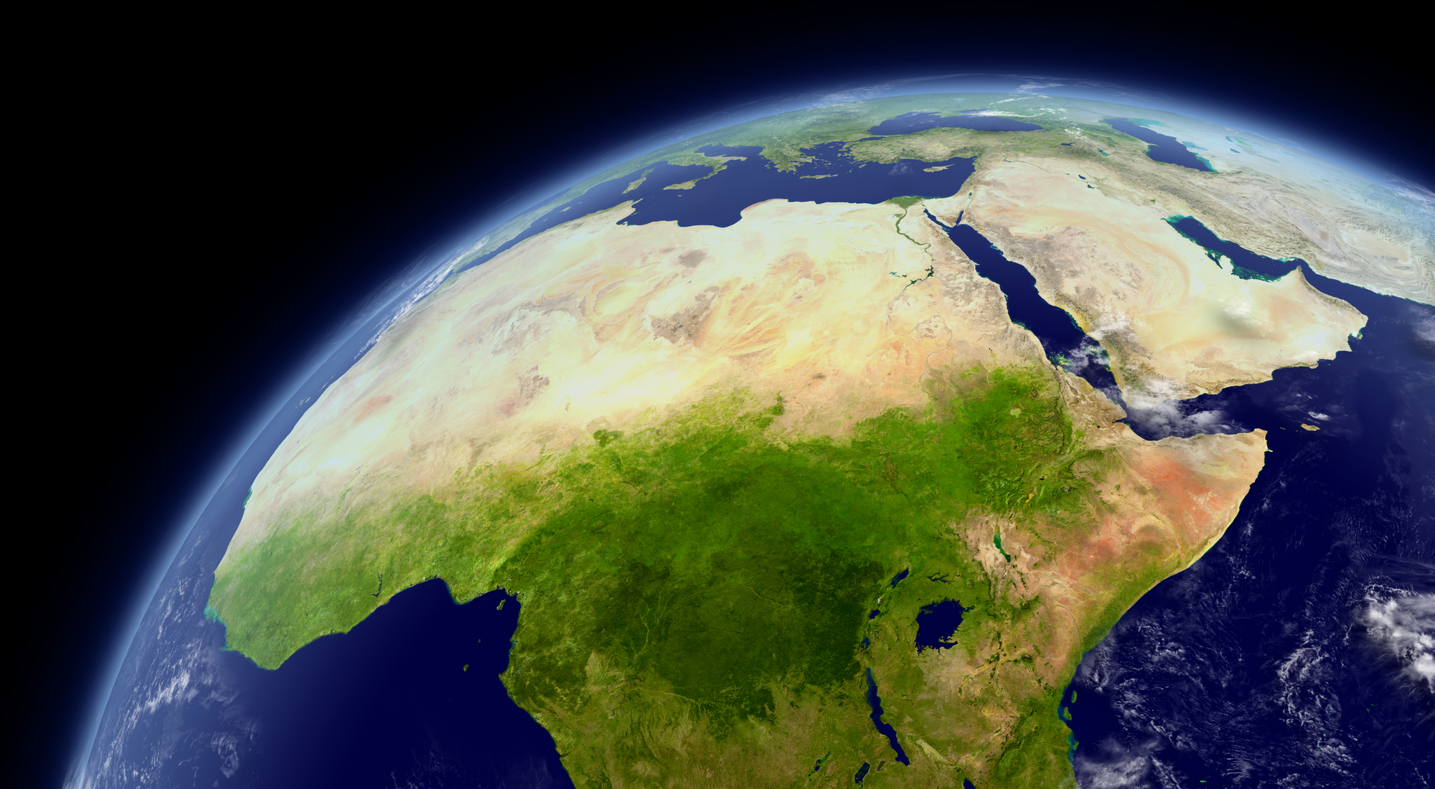
Satellite image of the Sahara, North Africa

Slide 14
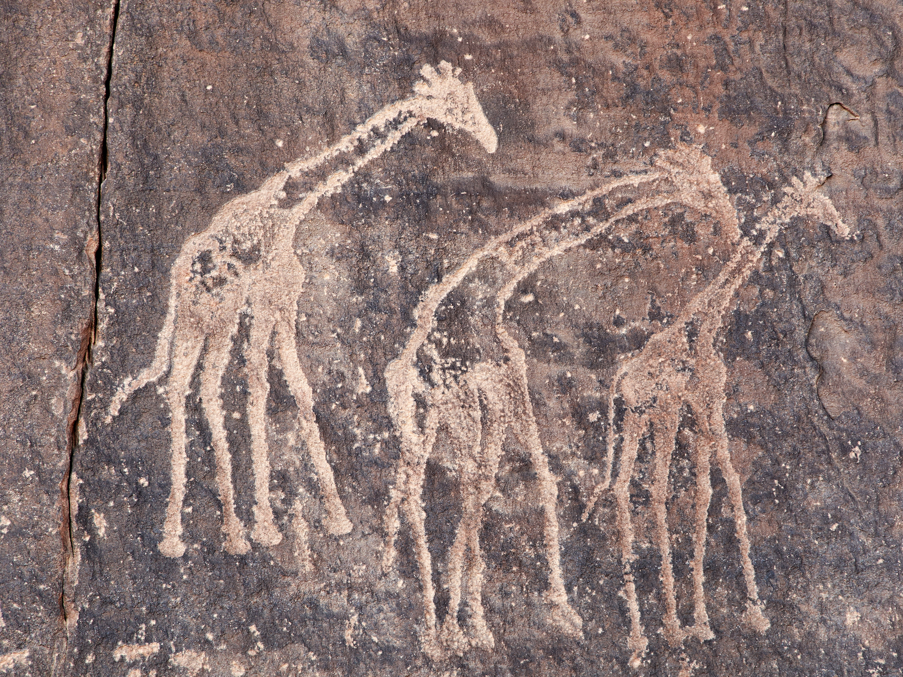
Ancient rock engravings in the Sahara Desert

Slide 15
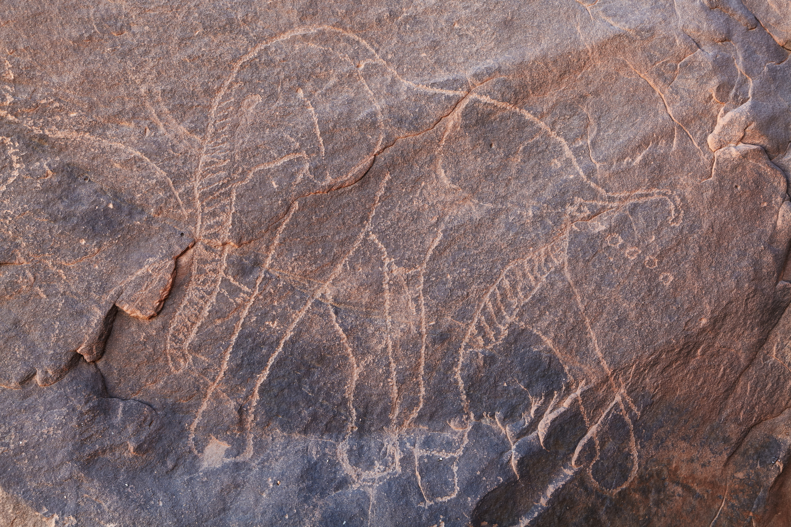
Rock art shows that elephants were once widespread across much of the Sahara

Slide 16
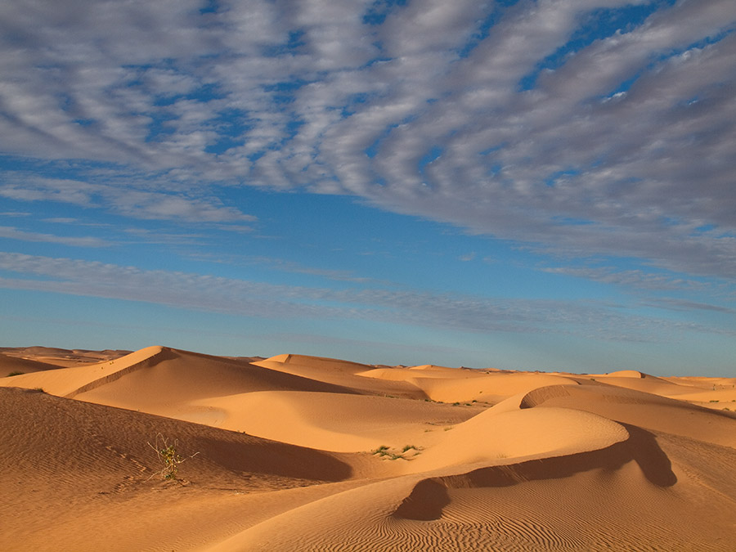
Sand makes up only 30% of the Sahara
Photo: Evgeni Zotov

Slide 17
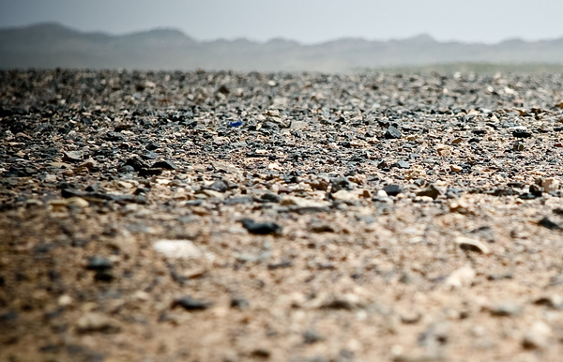
The other 70% is covered with gravel and stone
Photo: Ramon Rosati

Slide 18
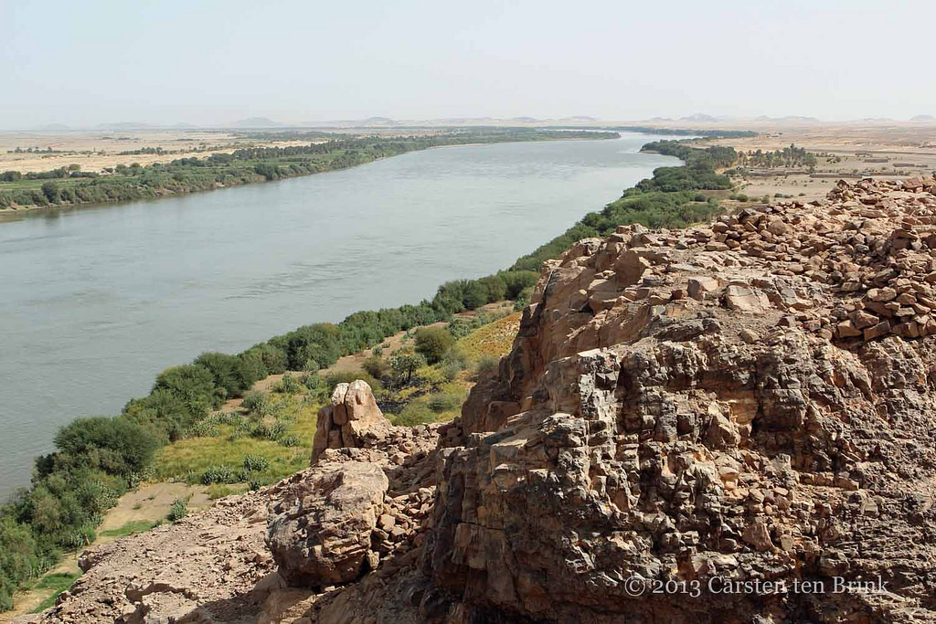
The Nile flows north through the Sahara creating a long oasis in the desert and eventually drains into the Mediterranean Sea
Photo: Carsten ten Brink

Slide 19
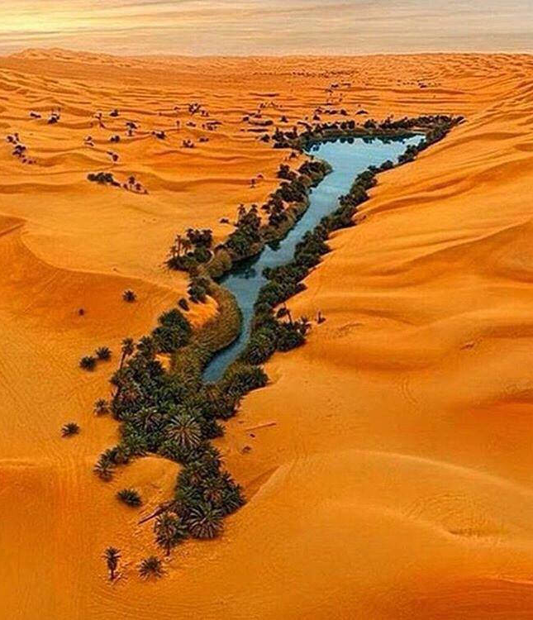
An oasis is an isolated fertile area in a desert, normally around a spring or other water source

Slide 20
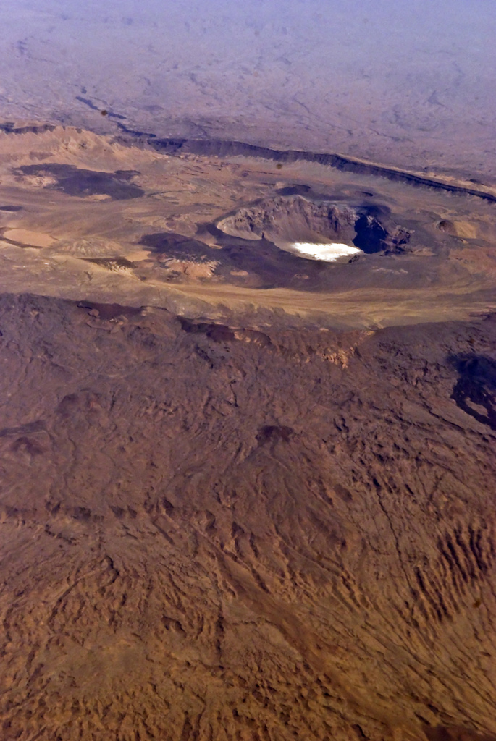
The highest point in the Sahara Desert is the volcano Emi Koussi (3,445 m high) in the Tibesti Mountains of Chad
Photo: Holly Ladd

Slide 21
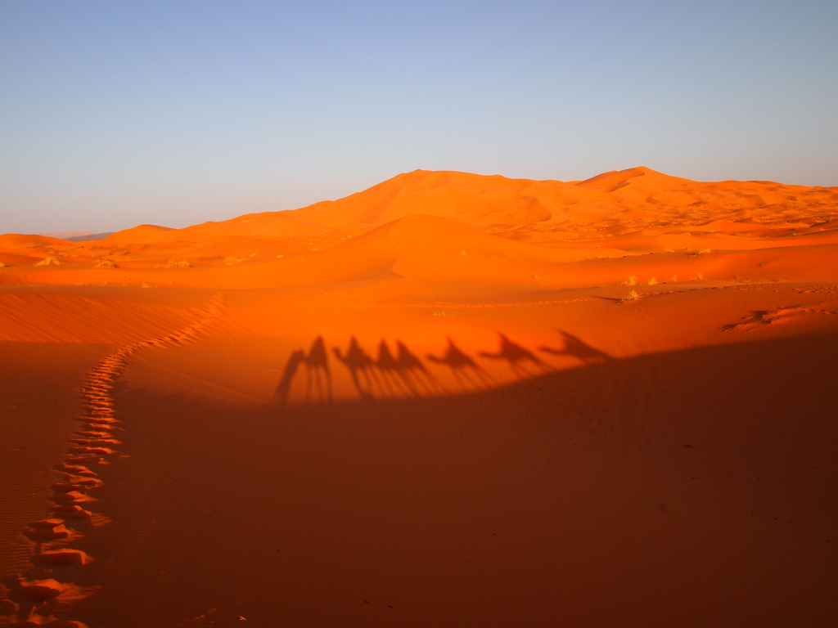
The Sahara is the hottest large area on Earth and in summer the temperature can soar to 47ºC
Photo: Melissa Youngern

Slide 22
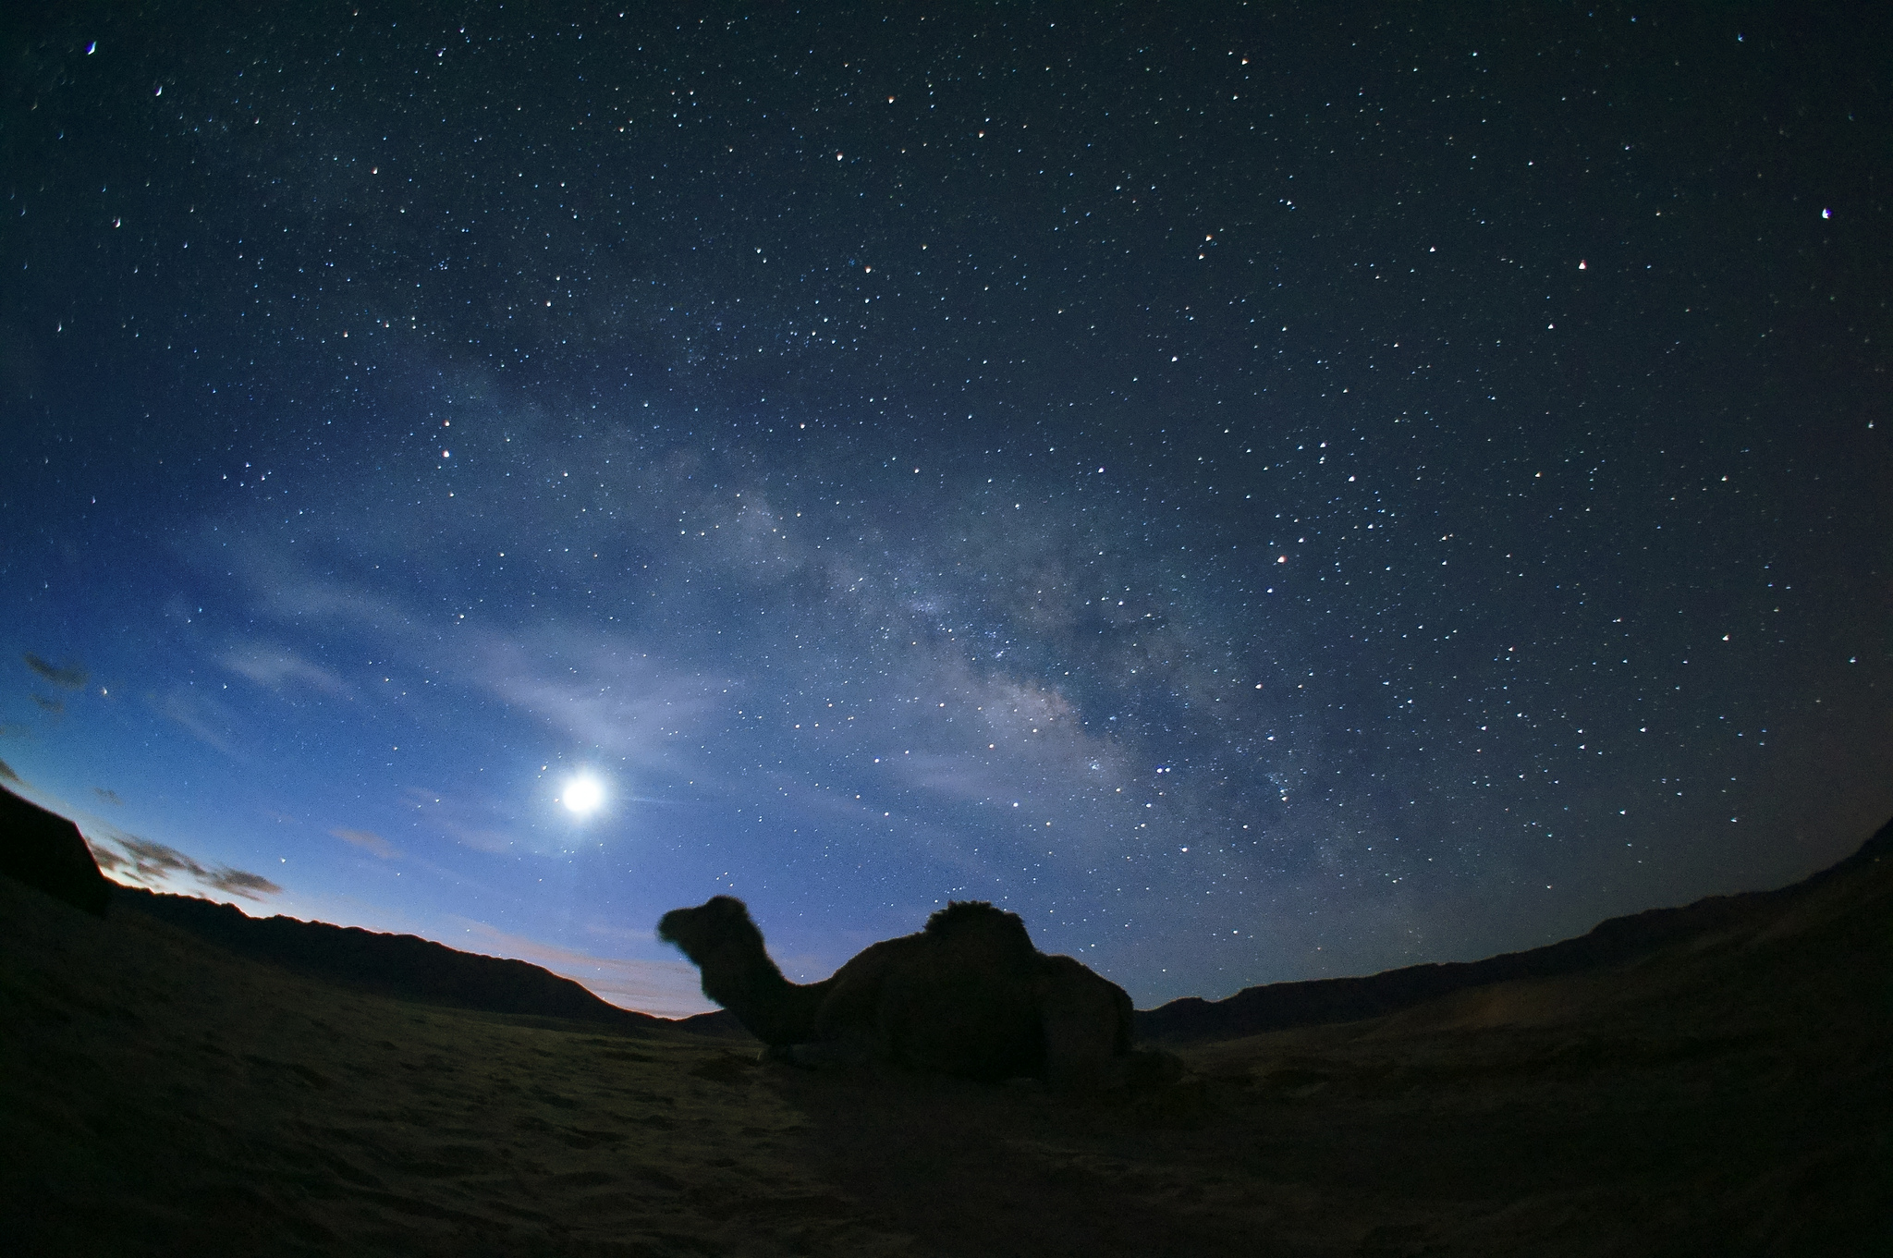
At night temperatures can drop rapidly, sometimes to below freezing
Photo: henrykkcheung

Slide 23
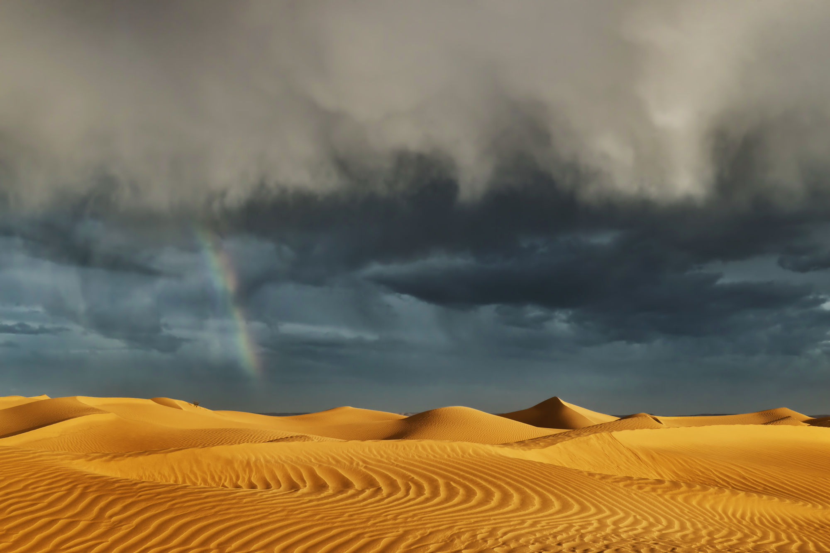
It rarely rains in the Sahara, but when the infrequent rains come they are often torrential

Slide 24
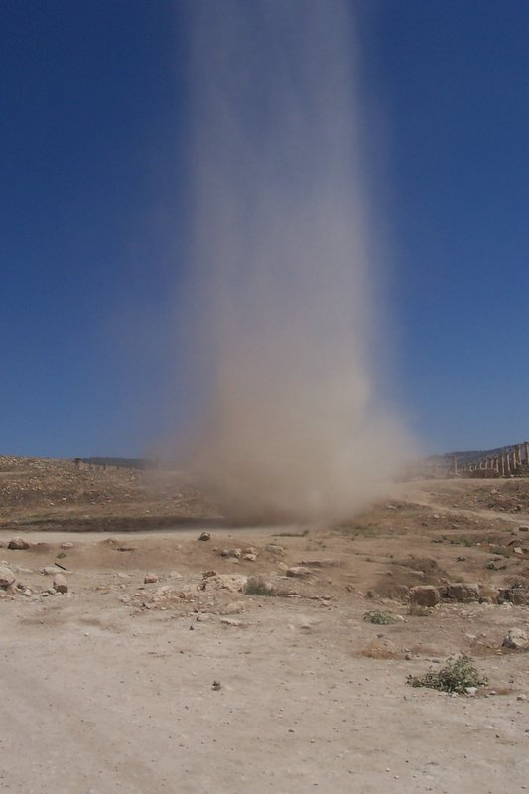
Dust devils are small whirlwinds containing sand or dust - they can happen almost daily in the Sahara during the hot season
Photo: abby chicken

Slide 25
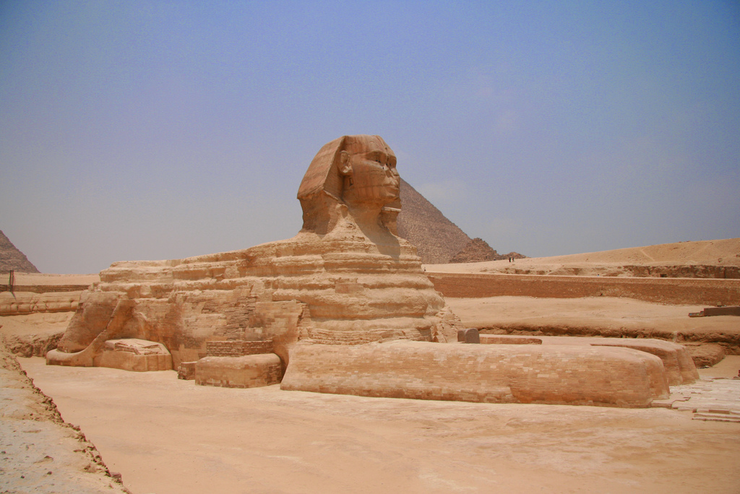
The Sahara is full of history - powerful civilisations formed here, such as the ancient Egyptians
Photo: Ben Jeffrey

Slide 26
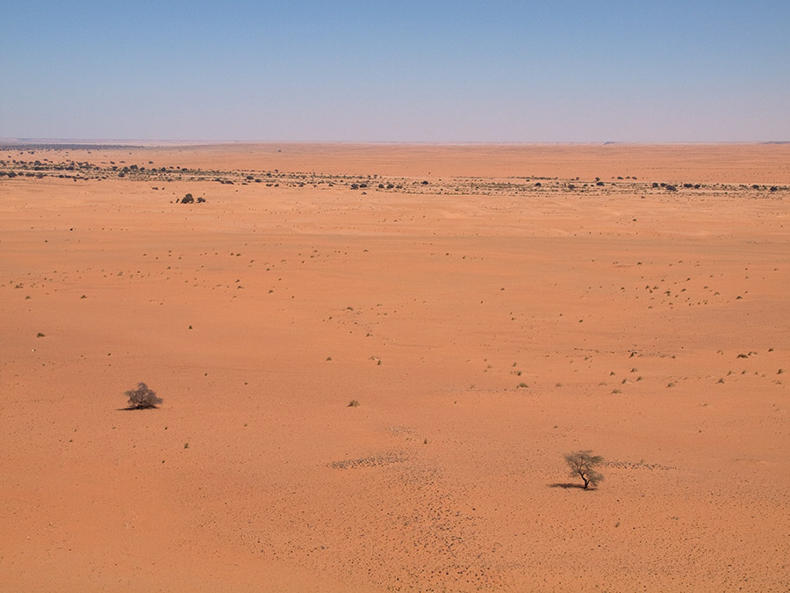
The Sahara has one of the lowest population densities on the planet and huge areas are completely empty.
Photo: Evgeni Zotov

Slide 27
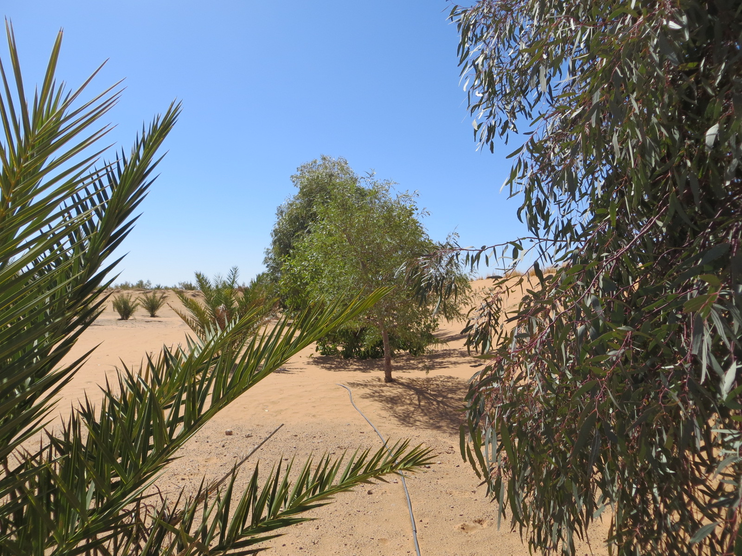
In oases, irrigation allows limited cultivation of fruit trees, cereals and vegetables.
Photo: yellow magpie

Slide 28
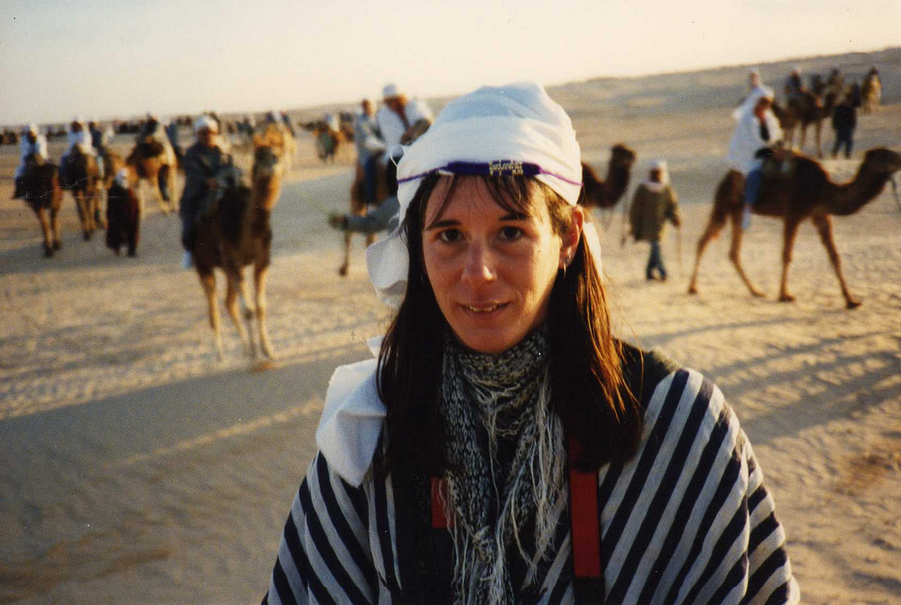
Most of the people who live in the Sahara have a nomadic lifestyle
Photo: Leonora (Ellie) Enking

Slide 29
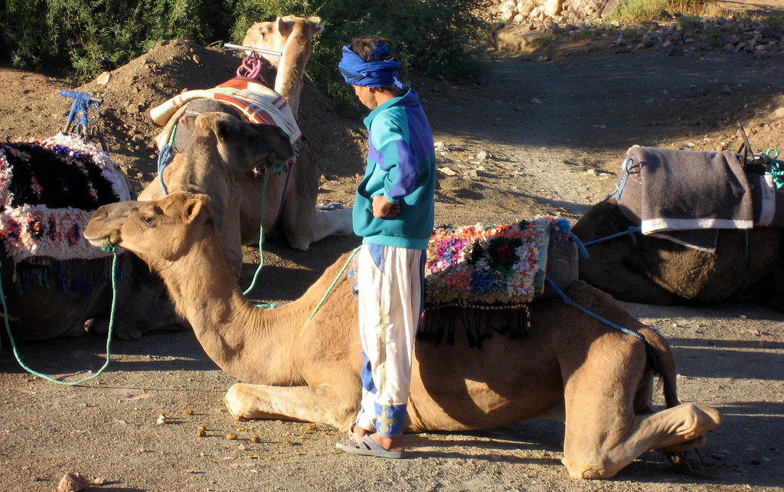
The Bedouin is a nomadic group who live in the Sahara Desert. Their traditional lifestyle is adapted to the arid conditions
Photo: wonker

Slide 30
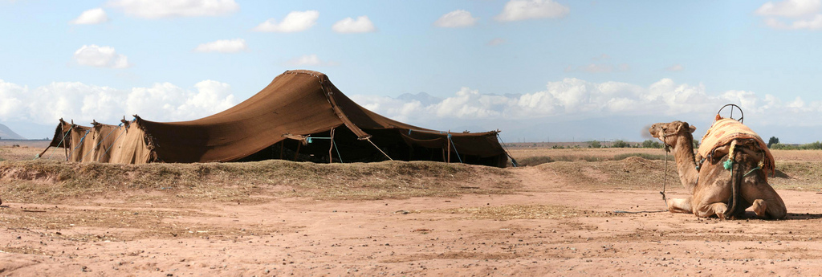
Bedouin tents are built to allow air to circulate within them, keeping them cool
Photo: UncleBucko
The Bedouin have herds of animals adapted to living in desert conditions, such as camels

Slide 31
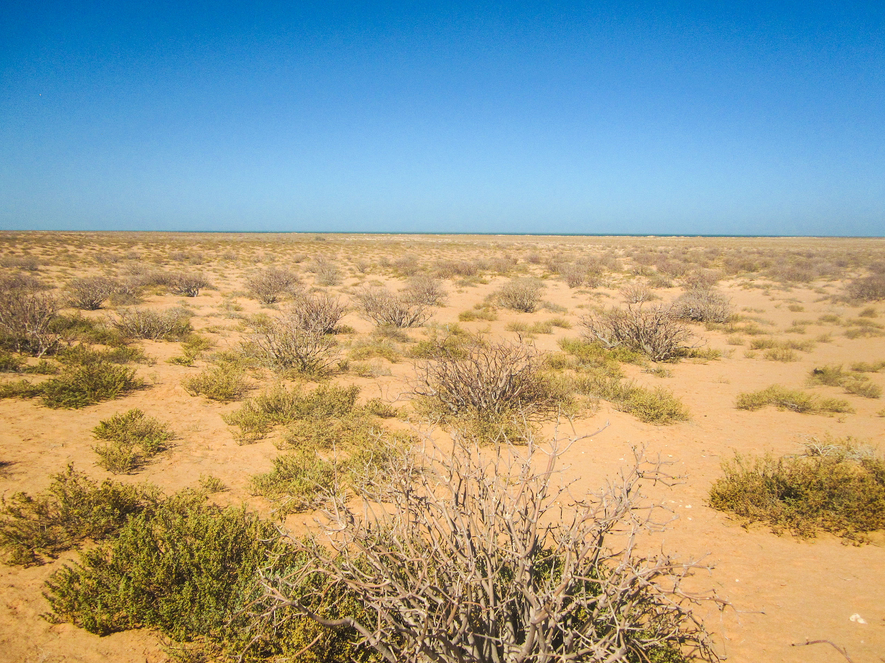
Plant life in the Sahara is sparse as there are such high temperatures and arid conditions
Photo: jbdodane

Slide 32
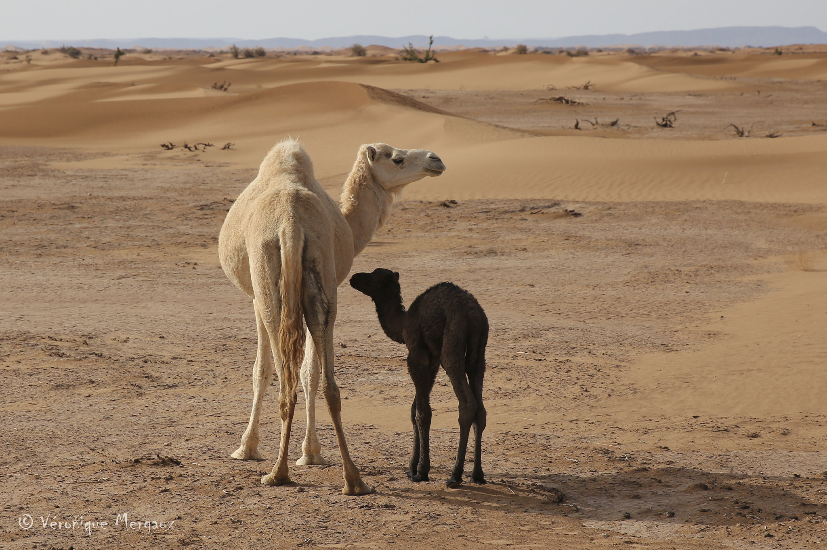
The Sahara Desert is home to a surprising number of animal species that are well-adapted to survive in the desert climate
Photo: Veronique Mergaux

Slide 33
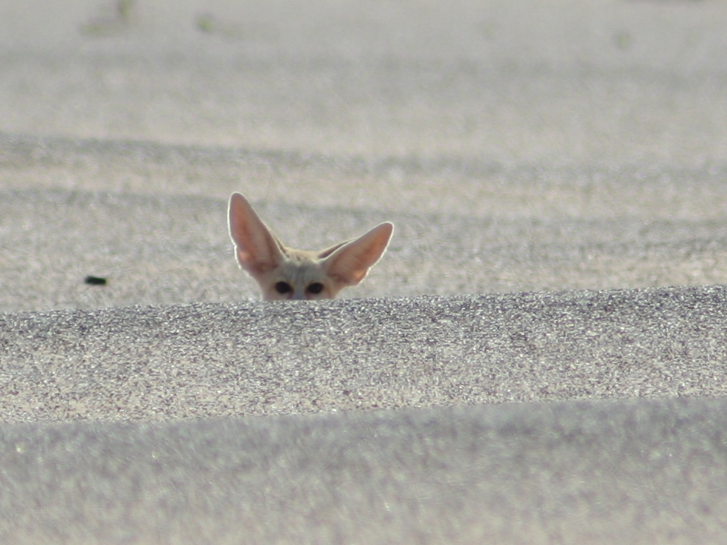
HOW ARE PLANTS AND ANIMALS ADAPTED TO LIFE IN THE SAHARA?
Photo: Christophe Andre

Slide 34
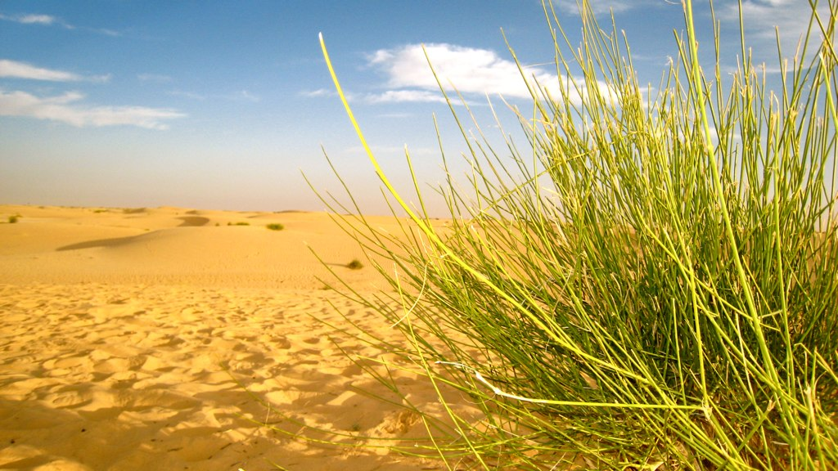
Some heat and drought tolerant grasses are found on the plains and plateaus of the Sahara
Photo: Steffan Dubouis

Slide 35
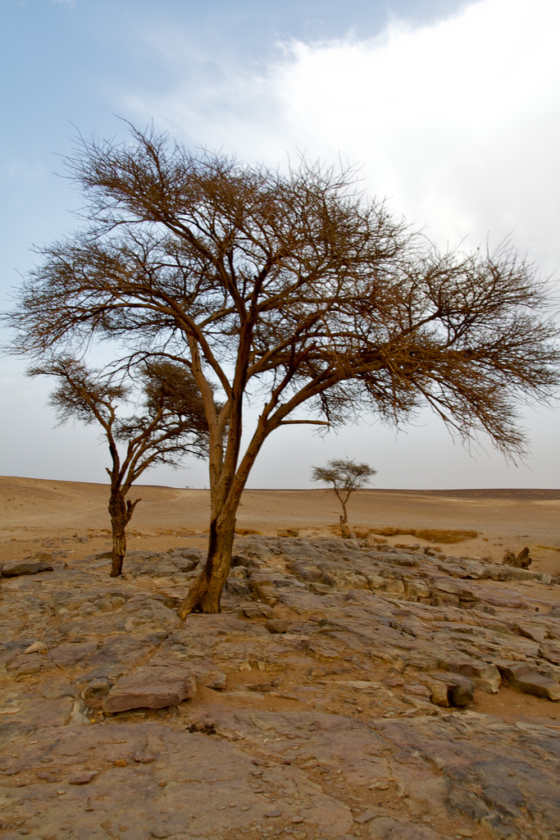
The Red Acacia is native to the Sahara. It bears feathery leaves which protect the bark of the tree from dry winds
Photo: eatwords

Slide 36
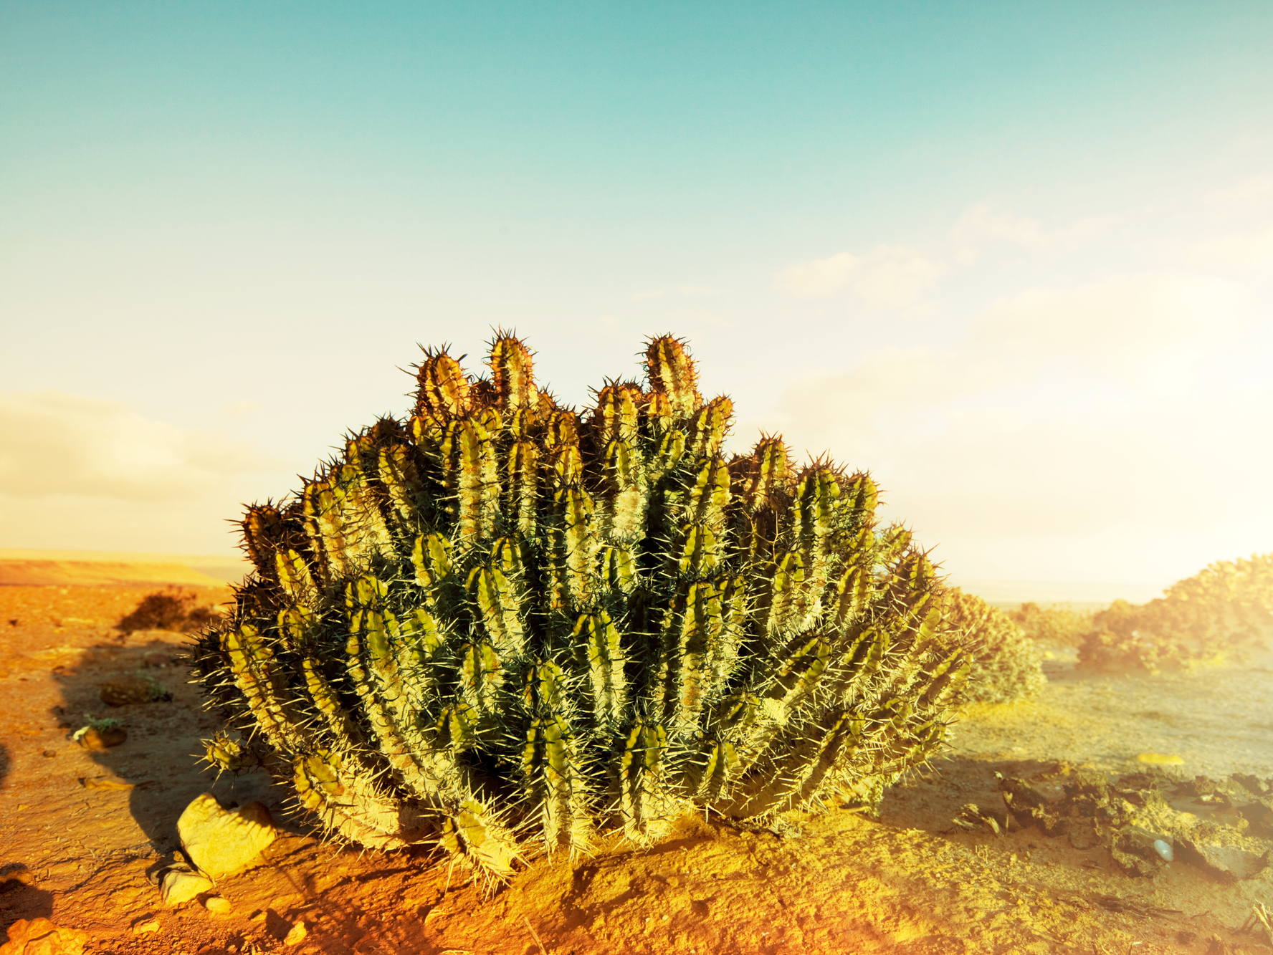
Cacti thrive in the desert environment as their thick stems can hold water for a long time

Slide 37
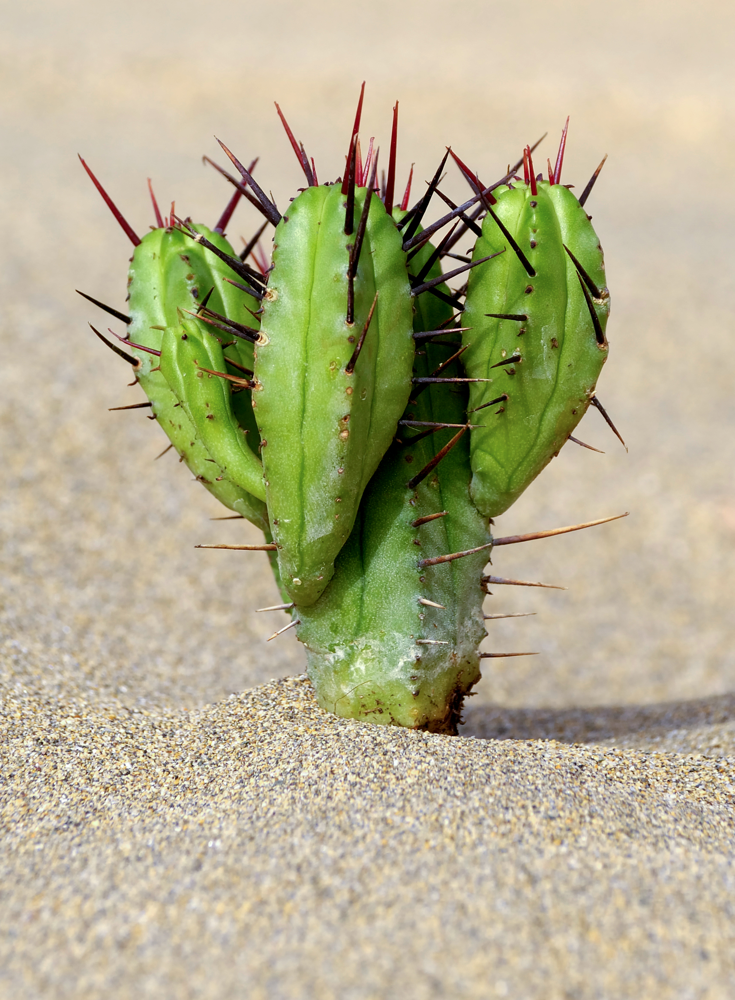
Cacti Adaptations
Thick waxy skin reduces water loss and reflects heat
Grow spikes instead of leaves – less area that sun can hit so reduces water loss.
Thick fleshy stems to store water
Spikes also protect cacti from animals looking for food
Very long roots that spread over a wide area to suck up every little bit of moisture they can find
Grows slowly – the plant needs to make less food so it doesn’t lose as much water
Shallow roots to collect surface water
Deep roots to tap groundwater

Slide 38
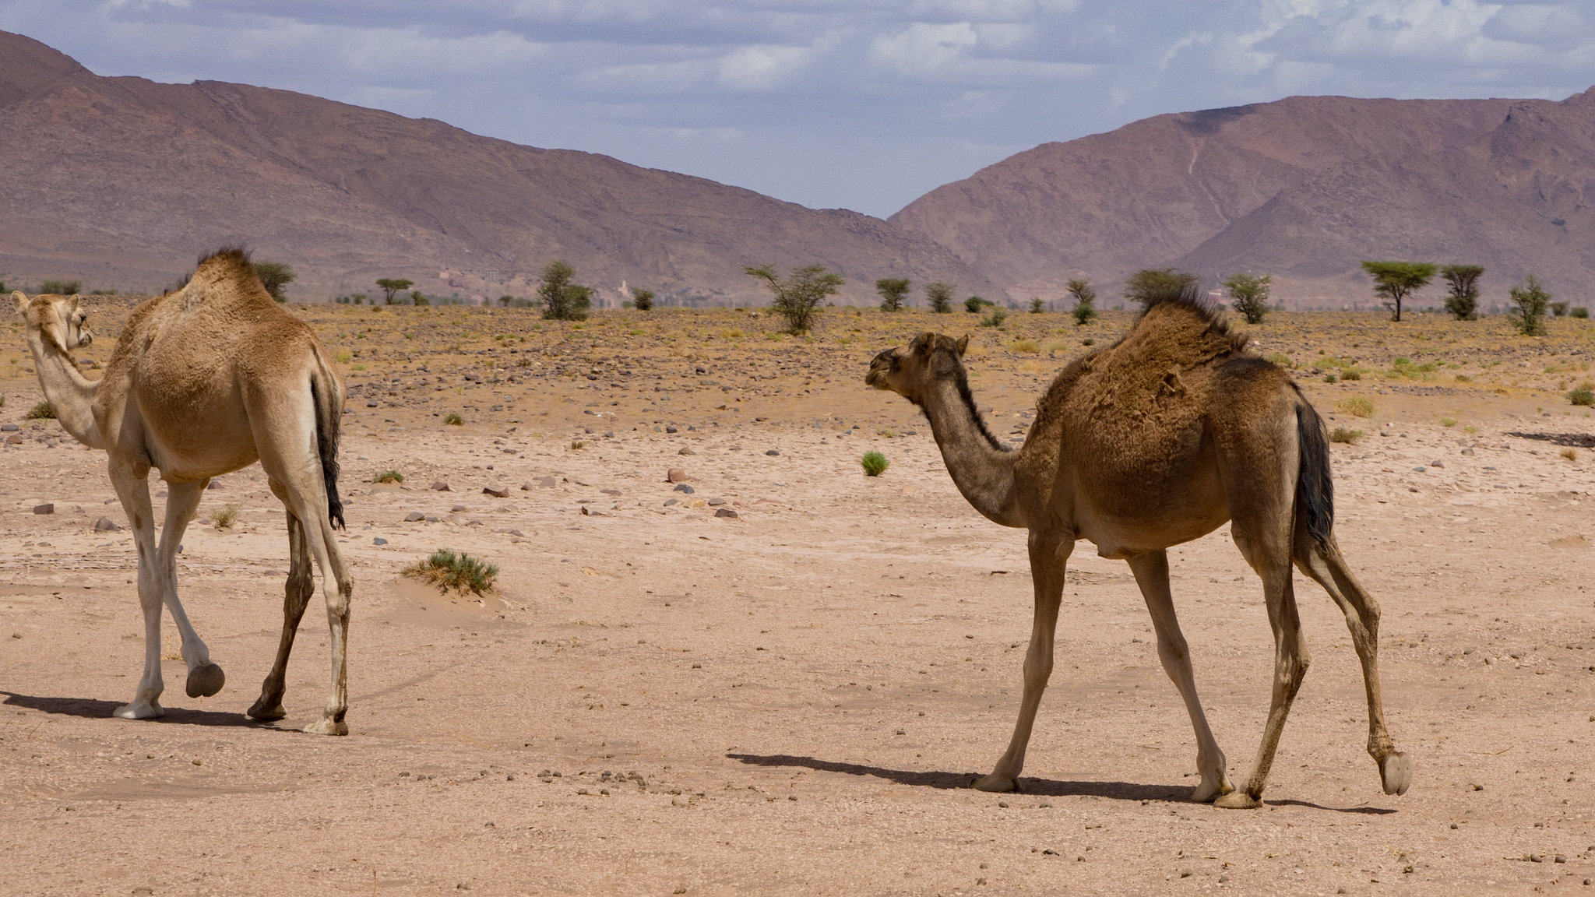
Camels are highly adapted to survive in the arid conditions of the Sahara
Photo: Gilbert Sopakuwa

Slide 39
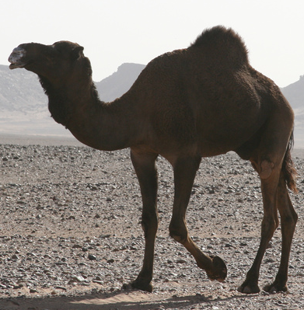
Dromedary Camel Adaptations
Long eye lashes, hairy ears and closing nostrils – to keep sand out
Thick eyebrows which stand out – shade eyes from the sun
Thick lips so they can eat prickly desert plants without pain
Store fat in humps so can go for several months without food
Wide feet that do not sink into the sand
Thick fur on top of body for shade and thin fur elsewhere to allow easy heat loss
Drink gallons of water in one go, so they can go without water for over a week
Photo: katy_nicolson
Soft feet aligned so can move quickly and easily through the sand
Body temperature can change throughout the day to avoid losing water through sweating
Well camouflaged

Slide 40
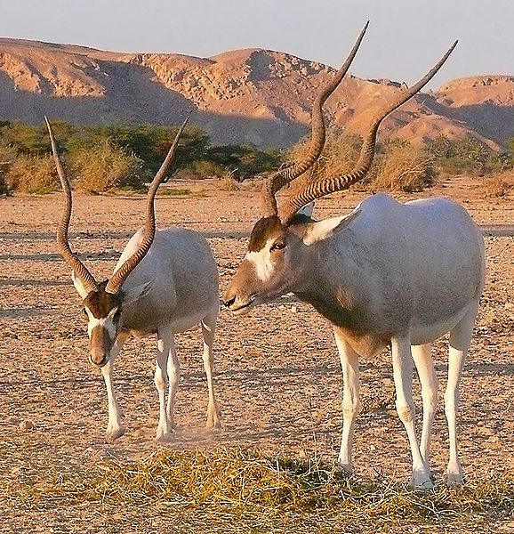
The Addax antelope is well-adapted to exist in its desert habitat, as it can live without water for long periods of time.
Photo: vivtony00

Slide 41
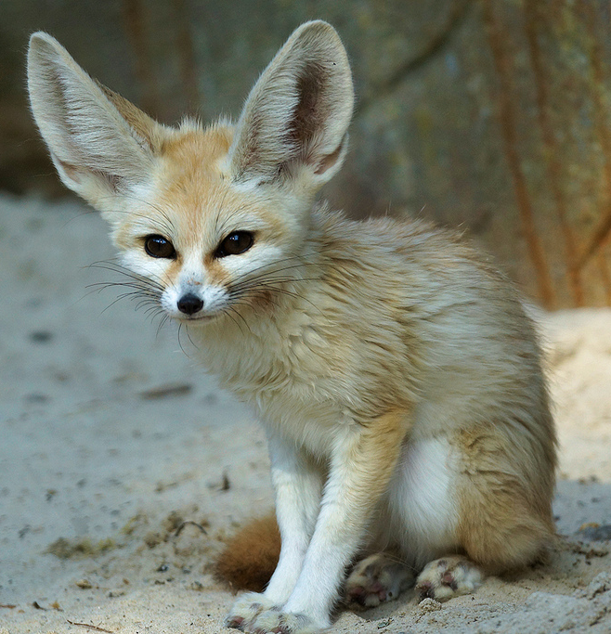
Fennec Fox Adaptations
Avoid the worst heat of the desert by living in burrows during the day and emerging at night
Very large ears – their large surface area allows a lot of body heat to be lost to the air
Long, thick fur insulates them on cold nights and protects them from hot sun in the day
Sandy coloured fur helps reflect heat and gives excellent camouflage in the desert
Thick fur on soles of feet protects them from hot sand.
Photo: Helen Haden
Their feet are also effective shovels for digging their underground dens
Can survive without water for long periods of time as they get fluid from the food they eat. Their kidneys are also adapted to restrict water loss

Slide 42
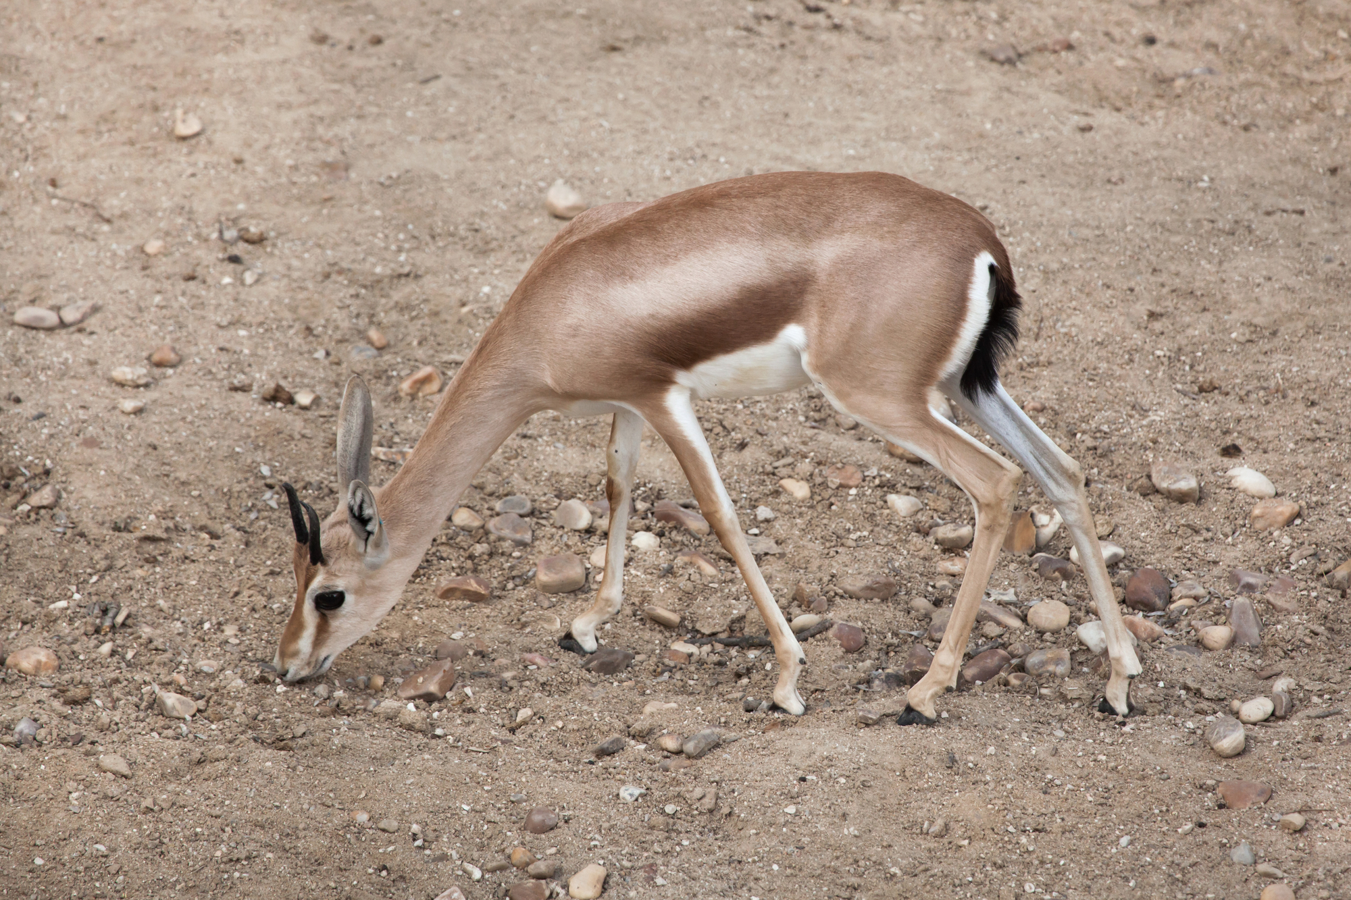
The dorcas gazelle can go without drinking for its entire lifetime as it gets the moisture it needs from the plants it eats

Slide 43
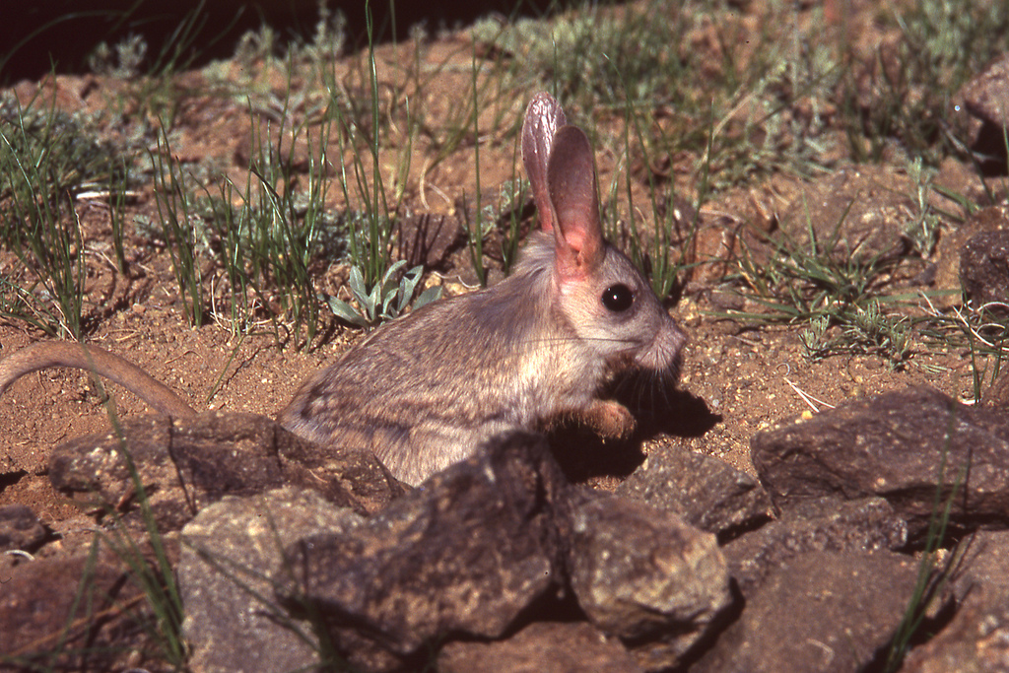
Jerboas are nocturnal. During the heat of the day they shelter in burrows and leave them at night when it is cooler
Photo: tgran

Slide 44
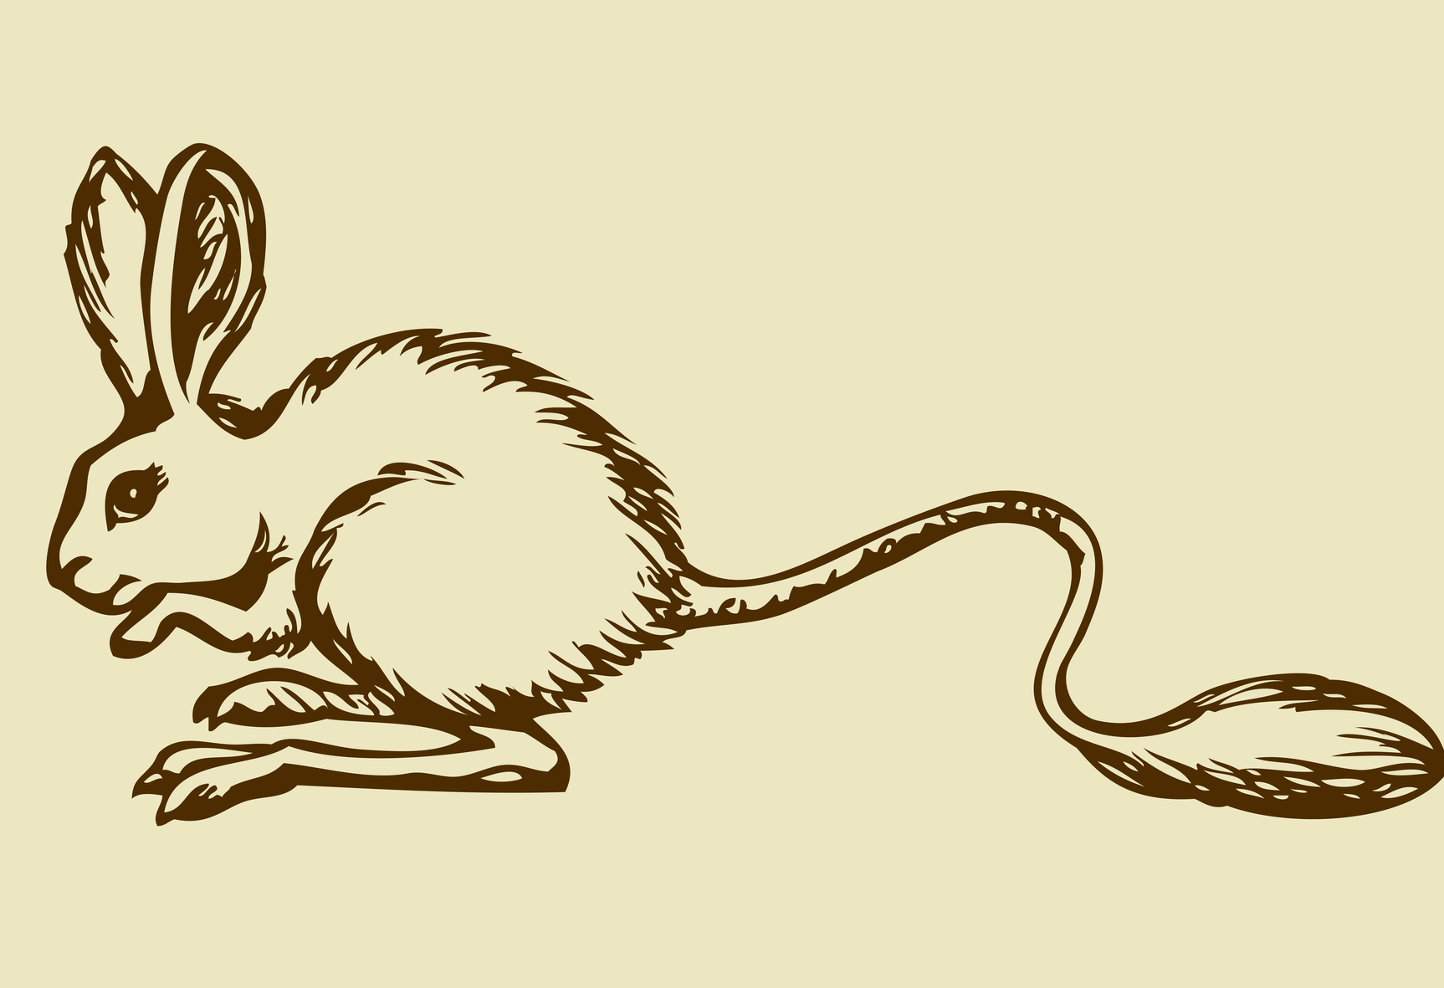
Jerboa Adaptations
Special hairs to stop sand from getting in the ears
Can get all the water it needs from the vegetation ad insects it eats
Long back legs for travelling quickly whilst using minimal energy
Fold of skin that can close off nostrils to sand
Short forearms and powerful hind legs for digging
When chased can run at up to 24 km/hour
Uses burrowing systems to escape extreme heat or cold

Slide 45
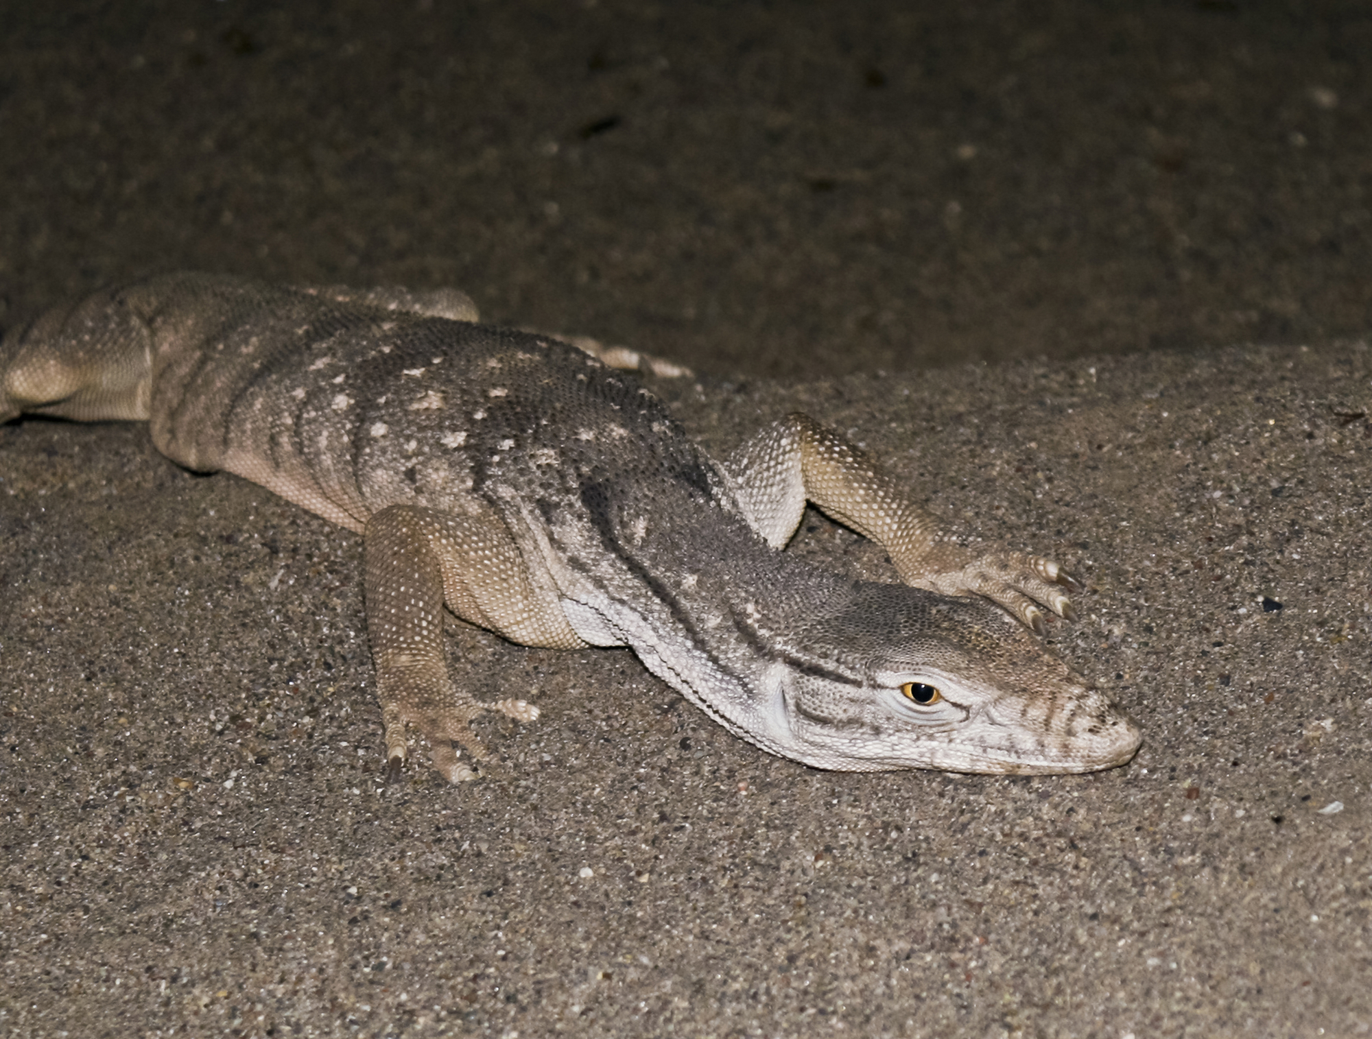
The monitor lizard’s perfectly adapted skin allows it to withstand the scorching heat of the Sahara

Slide 46
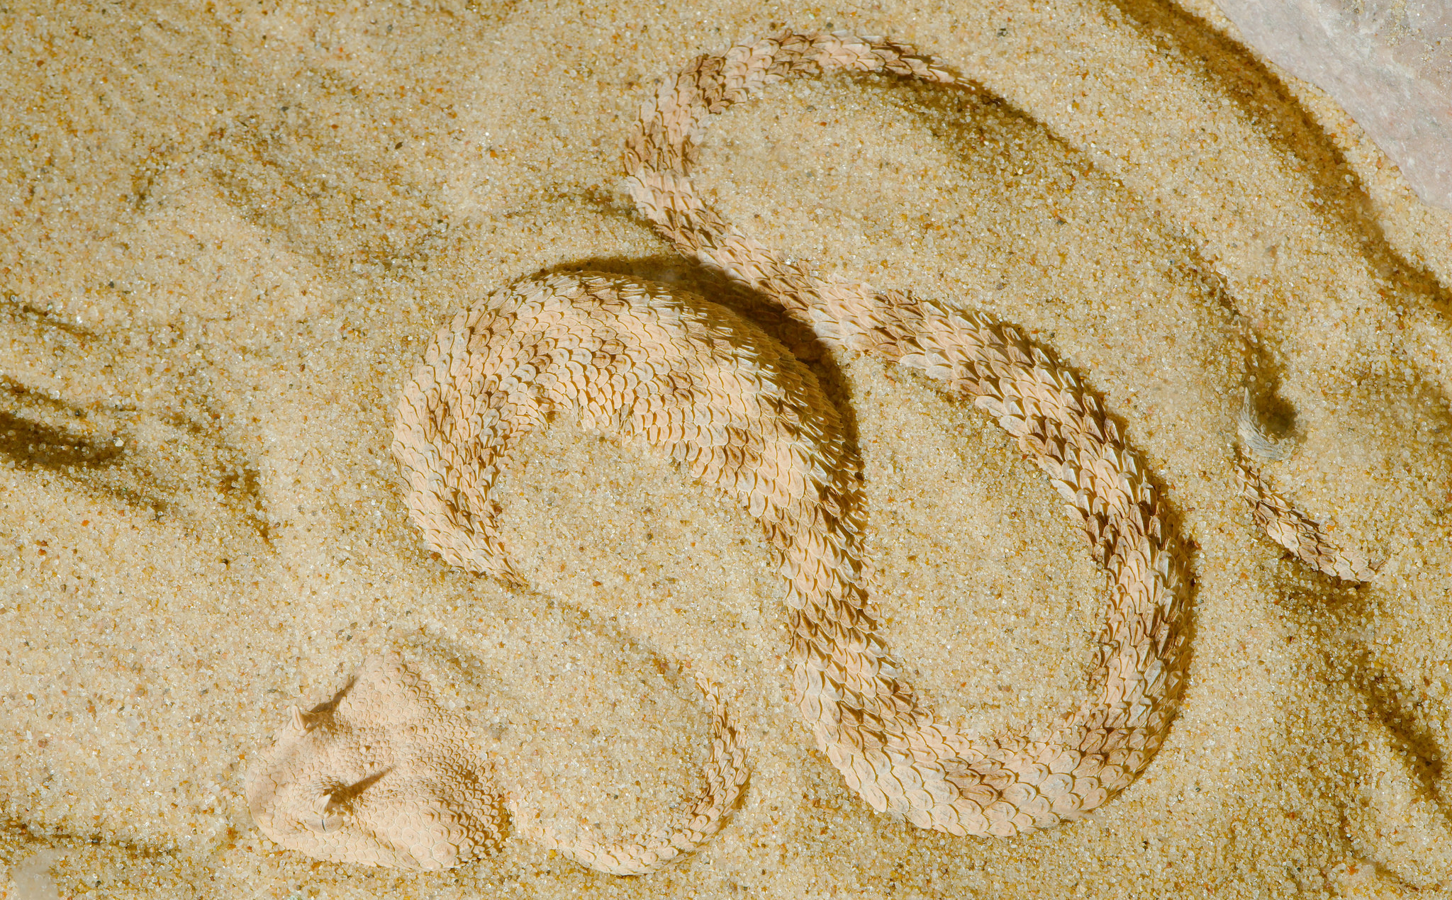
The unique sideways movement of the horned desert viper helps it move across the sands quickly and effectively
Photo: Josh More

Slide 47
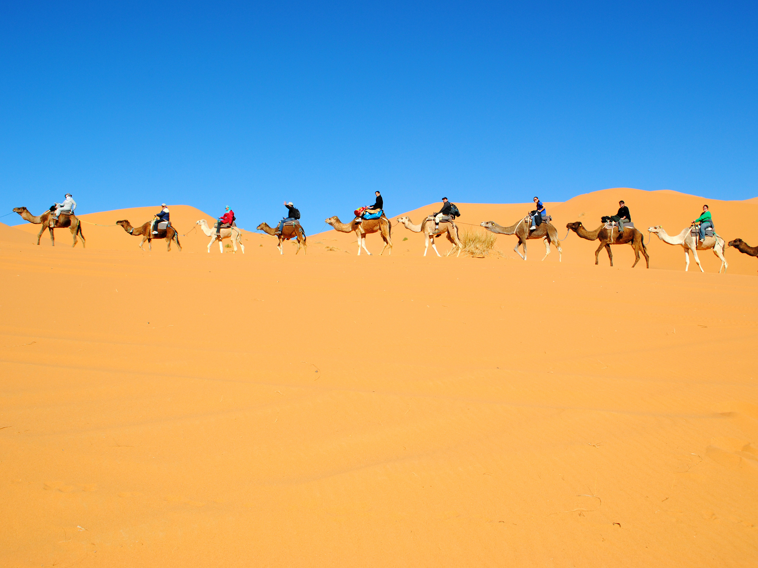
HOW ARE HUMANS AFFECTING THE SAHARA?
Photo: Cait

Slide 48
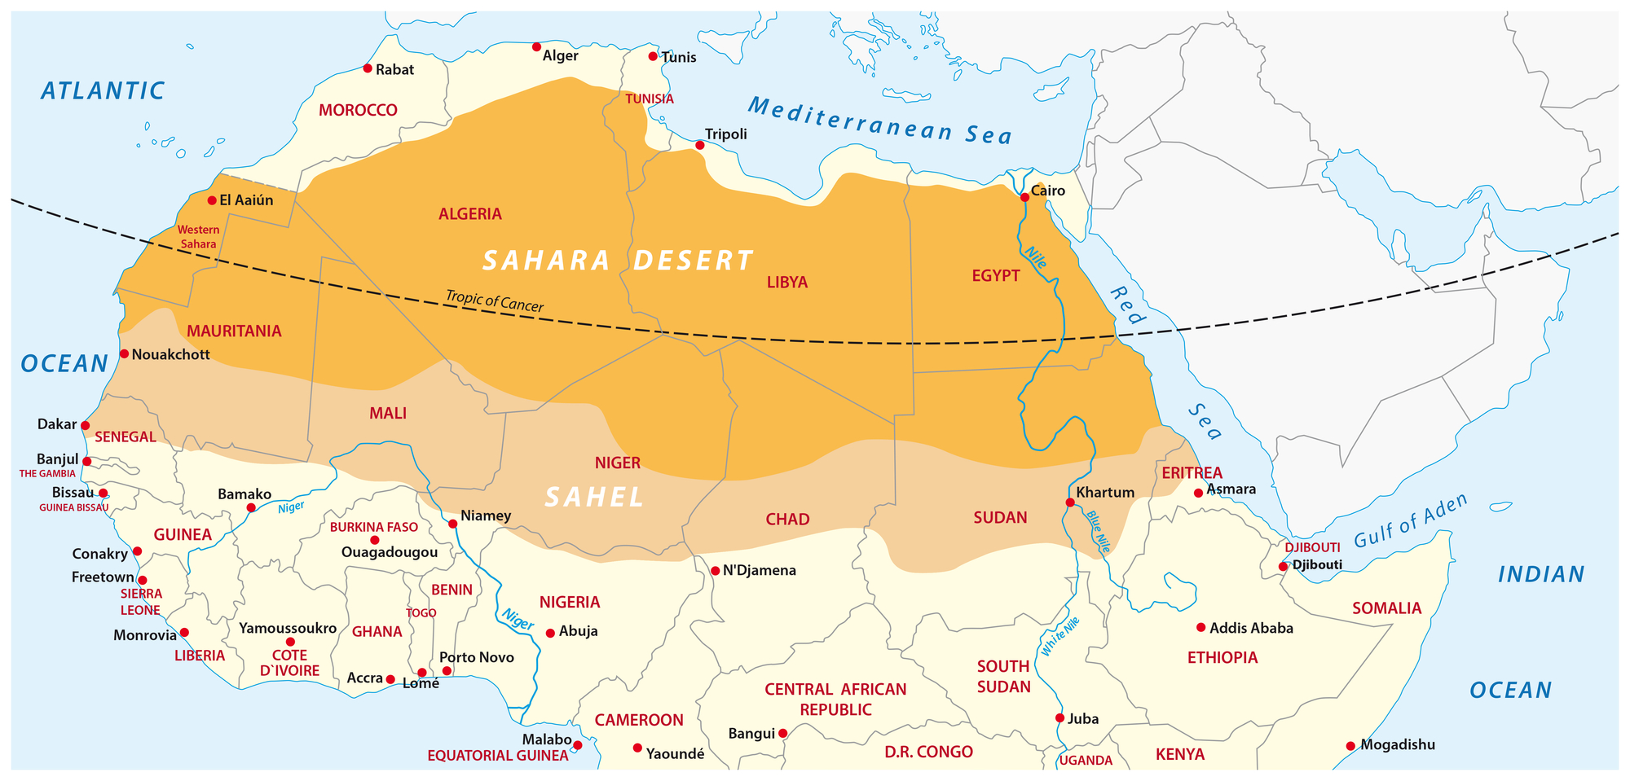
The Sahel is a semi-arid region
just to the south of the Sahara

Slide 49
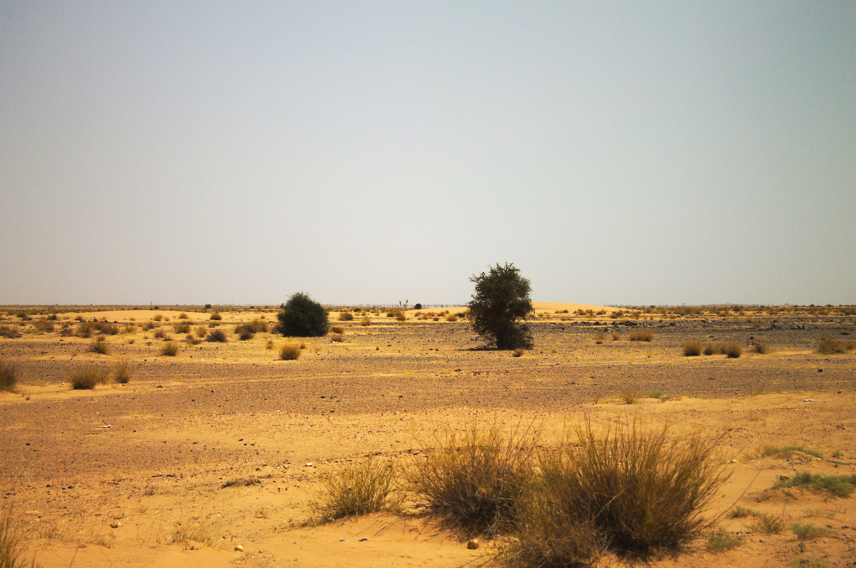
Desertification is the process that sees a relatively dry area of land, like the Sahel, become increasingly arid.
Photo: Ammar Hassan

Slide 50

Some statistics show that since 1900, the Sahara has expanded by 250 km to the south, along a 6,000 km long front. Around one third of this is thought to be due to climate change.

Slide 51

Over cultivating the land means it doesn’t have a chance to recover and all the nutrients in the soil are used up
Photo: Oxfam International

Slide 52

This land has been overgrazed - the animals have eaten all the vegetation, leaving the bare soil open to erosion. Now this herder cannot find any pasture for his cows.
Photo: Oxfam International

Slide 53

Cutting down trees for fuel and shelter leaves the soil open to erosion

Slide 54

The Sahel’s population growth rate is among the world’s highest, so there is more and more demand for food and fuel
Photo: European Commission DG ECHO

Slide 55

Humans are increasing the amount of greenhouse gas in the atmosphere by activities such as burning fossil fuels
Photo: Darren Flinders:

Slide 56

Many scientists believe global warming will result in increased rates of desertification in the Sahel
CIFOR

Slide 57

Low rainfall and over-cultivation of the land has led to failed crops and poor harvests in the Sahel
Photo: Oxfam International

Slide 58

Many families in the Sahel region do not have enough food and suffer from high malnutrition
European Commission DG ECHO

Slide 59

In 2019, over 33 million people are classified as ’food insecure’.
Photo: LM TP

Slide 60

Terracing the hills to retain topsoil, nutrients and water has resulted in better soil and harvests
Photo: World Bank Photo Collection

Slide 61

The Great Green Wall is a project which aims to grow an 8,000km ‘wall’ of trees along the edges of the Sahara to try and stop desertification
Photo: Pencils for Kids

Slide 62

Tourists visit the Sahara for many reasons – the peace, the breath-taking landscape, the history and culture of this unique region
Photo: Jill/Blue Moonbeam Studio

Slide 63

Off road vehicles harm the fragile desert ecosystem

Slide 64

The addax antelope is now critically threatened with extinction, mainly due to over-hunting
Photo: cuatrok77

Slide 65
To find out more, please visit
ypte.org.uk
Registered charity number 1153740
Creating a better future by inspiring young people to look after our world

Slide 66
Credits
YPTE would like to thank all the amazing photographers on Flickr who allow the use of their photos for non-commercial purposes.
Your photos are helping young people to learn more about environmental issues. We couldn’t have created this presentation without you!

